Slide 1



STUDENT MANAGEMENT SYSTEM
PROJECT MEMBERS :
NIRANJANA Y(23CDR110)
MUTHAMIL S(23CDR104)
REVIEW 2 : 15/3/25

Slide 2
Advantage
Centralized Data
Data Accuracy
Security and Role-Based Access
Disadvantage
Requires Internet and Power
Maintenance and Updates

Slide 3
Feasibility
Technical Feasibility
The system can be developed using existing technologies (e.g., web frameworks, databases, servers).
Required hardware and software tools are readily available.
Operational Feasibility
Staff, students, and faculty can adapt to the system after training.
Enhances overall efficiency and communication in the institution.
The system simplifies and speeds up administrative tasks.
Economic Feasibility
Initial development or purchase may require investment in software, hardware, and training.
3

Slide 4
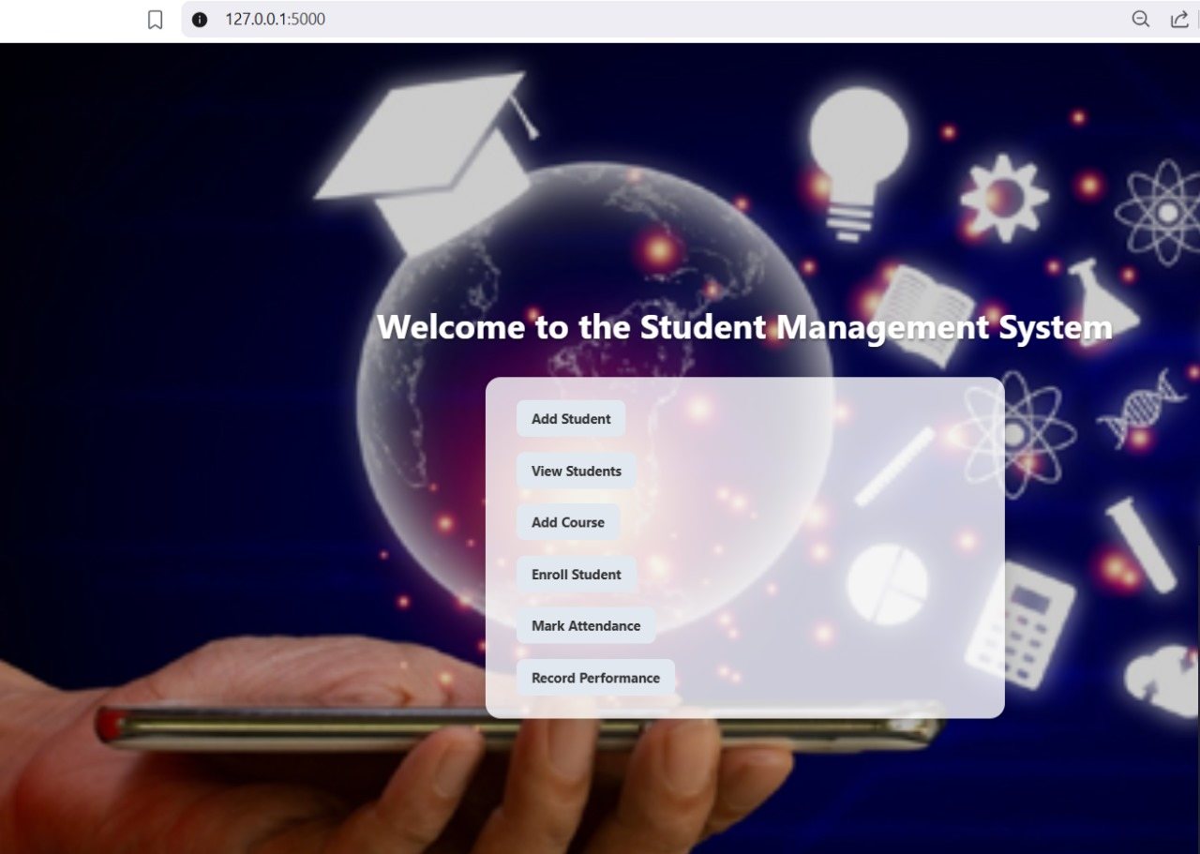
Implementation details
1.LOGIN
1.1 SIGNUP
2.INDEX PAGE
2.1 ADD STUDENT
2.2 VIEW STUDENTS
2.3 ADD COURSE
2.4 ENROLL STUDENTS
2.5 MARK ATTENDANCE
2.6 RECORD PERFORMANCE
4

Slide 5
1. Frontend
Features:
• Clean and organized HTML templates
• Forms for user input with server-side validation via Flask.
• Role-specific pages for students and staff.
• Bootstrap for consistent layout, responsive grids, and styled buttons/forms.
• URL routing for seamless page navigation.

Slide 6
Backend
Server-side form handling and validation to ensure data correctness.
Session management for user login persistence across pages.
MySQL database integration using mysql.connector for real-time data storage and retrieval.
Templates integrated with Bootstrap for clean and mobile-friendly UI.
Structured URL routing for seamless navigation across pages (/login, /signup, /add_student, /view_students, /mark_attendance, etc.).

Slide 7
Database
Stores users (students) securely with hashed passwords.
Keeps records of students, courses, enrollments, attendance, and grades.
Links students and courses using IDs.Makes it easy to:Add new students and courses.
Enroll students into courses.Mark attendance.Record performance (grades).
Organized into separate tables to avoid confusion.

Slide 8
Thank you!

